Slide 1
IMPROMTU SPEAKING

Slide 2
Consider just a few situations of impromptu speaking: 1. Introducing yourself to an events. 2. Filling in for a late speaker. 3. You are asked to give a toast at a company party. 4. You get asked a question you did not prepare for while on a panel. 5. Job interview questions from left field.

Slide 3
6. You are interviewed by a reporter. 7. You get pulled into a meeting to give an update. 8. Say a goodbye speech to a departing employee. 9. Your college refers to you in the middle of a presentation for input.

Slide 4
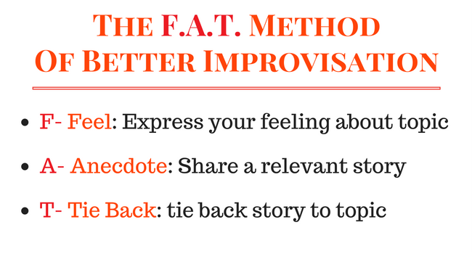
F A T

Slide 5
F = Feeling Share your honest feeling about the topic, circumstance or person. If you feel excited to be there then, that’s the impression that you share (remember to stay close to the truth)

Slide 6
A= Anecdote Share a relevant story. Most of the time, I share my first experience with the topic. For example, if it’s a car, then I share a story about my first car in college. If it’s a person, then I share my first experience meeting the person. It does not have to be that way.

Slide 7
T = Tie Back After you are done with the anecdote, make sure you tie it back to the topic you are talking about. Example, if you are doing a toast for a departing coworker, and you share the story of the first time you meet her, you can tie back by saying, that after that event, you knew that she was destined for big things and that she will be missed when she leaves.

Slide 8
F: Feeling I want to thank Michael, Amey, and Kira for working with our department over the summer. Their work is greatly appreciated, and I don’t know how we would have done it without them (only say it this way if it’s the truth).

Slide 9
A: Anecdote I remember your first day. You were all quiet, taking notes and probably thinking oh my god what a mess. Then surprised us all by your initiative and how quickly you learned. With your help, we caught up on our financial audit.

Slide 10
T: Tie back We were so thankful to have you this summer and wanted to wish you the best in your academic career next year. I know some of you will be graduating, and I look forward to hearing from you. I hope you would consider coming back to work with us. Good luck!

Slide 11
Tips for performing – and presenting – under unexpected pressure. 1. Be confident 2. Focus on the audience 3. Less is more -Keep it short and to the point. Remember the Power of 3 – stick to three key points.

Slide 12
4. Have a structure -In the main section use a simple structure. For example: - Past / Present/ future - Cause / Effect / Remedy - Before / The Event / The Result 5. Primacy and recency -The audience will remember the first and last things you say.

Slide 13
6. Talk conversationally - Imagine you are speaking to your best friend and let yourself be authentic and natural. 7. Personalise your speech & have a relevant story - Share from personal experience. No need to research, no need to investigate, and no need to memorize anything.

Slide 14
8. Demonstrate powerful body language 9. Use a credible voice tone -Deliver your words slowly and use pauses. 10. Turn your impromptu session into a Q&A session

Slide 15
Tell us about a challenge that you experienced and how you overcame it.

Slide 16
Lets assume you won 1 million Jackpot, what would you do it?

Slide 17
The power of words

Slide 18
How do you see yourself ten years from now?

Slide 19
What will you do if you find out your current parents are not your biological parents?

Slide 20
If you were given the chance to change something from the past, what would it be?

